Slide 1
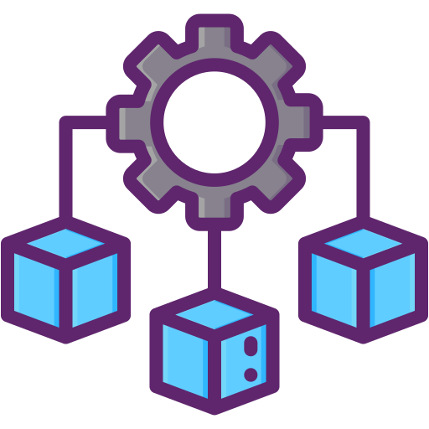
MicroServices

Slide 2
Agenda
Introduction
Monolithic Architecture
Disadvantages of Monolithic Architecture
Microservices
Advantages of Microservices
Design Pattern
kafka

Slide 3
Introduction
Microservices are a modern approach to software whereby application code is delivered in small, manageable pieces, independent of others.

Slide 4
Monolithic Architecture
Unified System, All-in-One Codebase.

Slide 5
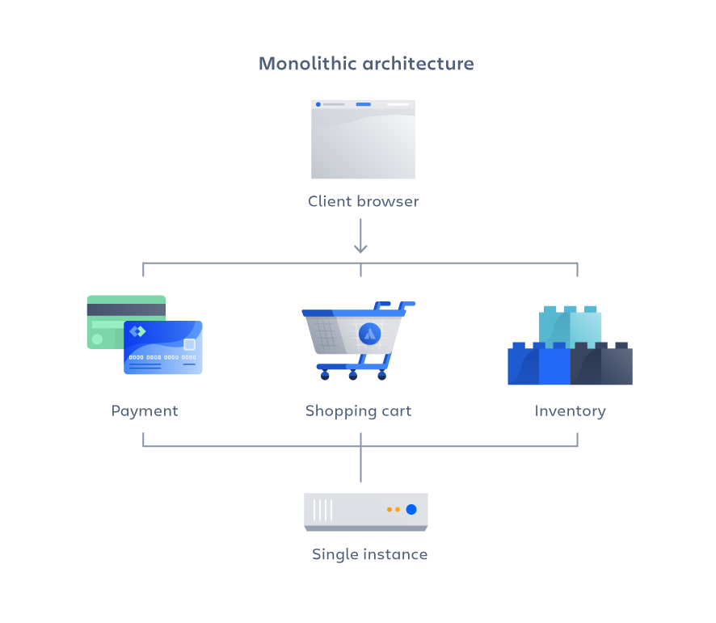
Monolithic Architecture
traditional software architecture model where an application is built as a single, unified unit. In this architecture, all components of the application—such as the user interface, business logic, and data access—are combined into one codebase.

Slide 6
Disadvantages Of Monolithic Architecture
Redeployment: Even a small change requires the redeployment of the whole application.
Scaling limitations: Monolithic applications are difficult to scale, as the entire system must be scaled, even if only one part needs more resources.
Tight Coupling: In a monolithic architecture, components are highly interdependent. This makes it difficult to isolate faults and develop or test individual components independently.
Single Point of Failure: A single bug can compromise the entire application.
Lack of flexibility. Using Monolithic Architecture you are tight to the technologies that are used inside your monolith. You cannot use other tools even if they are better for the problem at hand.

Slide 7
Microservices
Empowering Modern Application Development

Slide 8
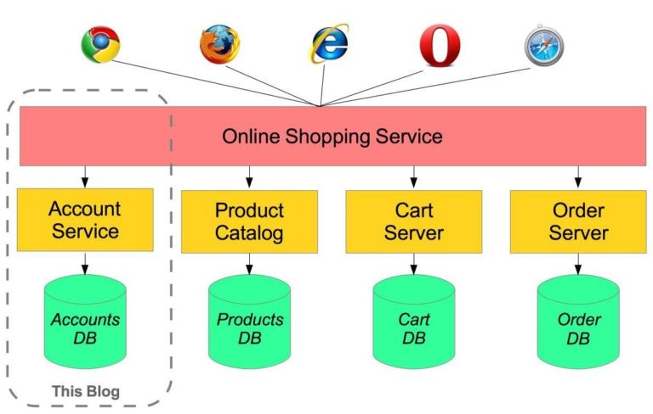
Microservices
Microservices is an approach where an application is built as a collection of small, independent services, each focused on a distinct task. These services communicate with each other through APIs.

Slide 9

Advantages Of Microservices
Scalability: Individual services can be scaled based on demand, improving resource utilization and eliminating the need to scale the entire application.
Rapid Development: Microservices enable rapid software delivery by allowing developers to work on small, independent parts of the application, which speeds up the digital transformation process.
Flexibility: Each service operates independently, allowing for changes or upgrades to be made individually without redeploying the entire application. There is also flexibility in technology choices.
Resilience: A failure in one service doesn’t impact the entire application, improving system reliability and fault tolerance.

Slide 10
Communication Between Services
Using Feign Client
Feign Client -
Feign Client is a tool that enables easy interaction with RESTful services by letting you create Java interfaces that represent the API, which are then automatically implemented to handle HTTP requests and responses
@FeignClient(name = "address-service", url ="http://172.31.2.11:9001/address")
public interface AddressService {
@PostMapping("/customer/{customerId}")
ResponseEntity<AddressDetails> addAddressDetails(@PathVariable("customerId") long customerId, @RequestBody AddressDetails addressDetails);
@GetMapping("/customer/{customerId}")
ResponseEntity<AddressDetails> getAddressDetailsByCustomerId(@PathVariable("customerId") long customerId);
}

Slide 11
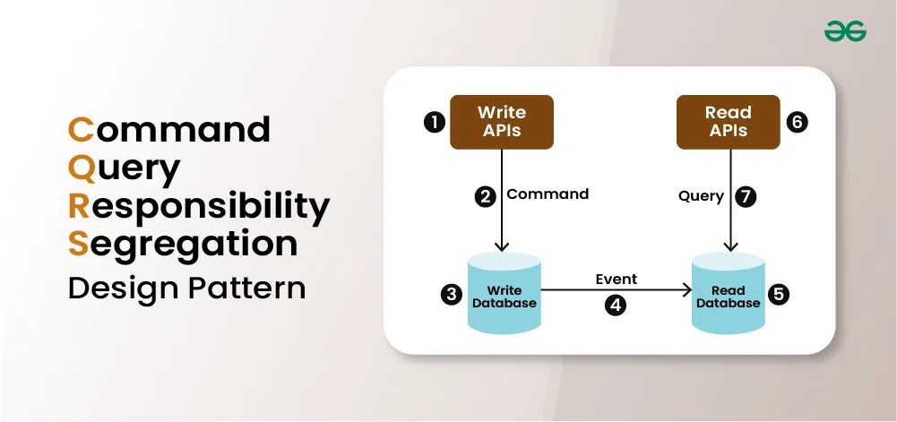
CQRS
The Command Query Responsibility Segregation (CQRS) design pattern has emerged as a powerful architectural pattern for building complex and scalable software systems. By separating the responsibilities of reading and writing data.

Slide 12
SAGA Design Pattern
SAGA pattern is a design pattern that is a long-lived sequence of smaller transactions. This pattern is used to manage and maintain data consistency across multiple microservices.
The Saga Pattern is a way to manage transactions across multiple microservices while maintaining data consistency in distributed systems. It works by publishing events to update the database after each successful step. If any step fails, a compensating method is triggered to undo the previous actions, ensuring consistency.
Types of Saga Pattern
Choreography-Based
Orchestration-Based

Slide 13
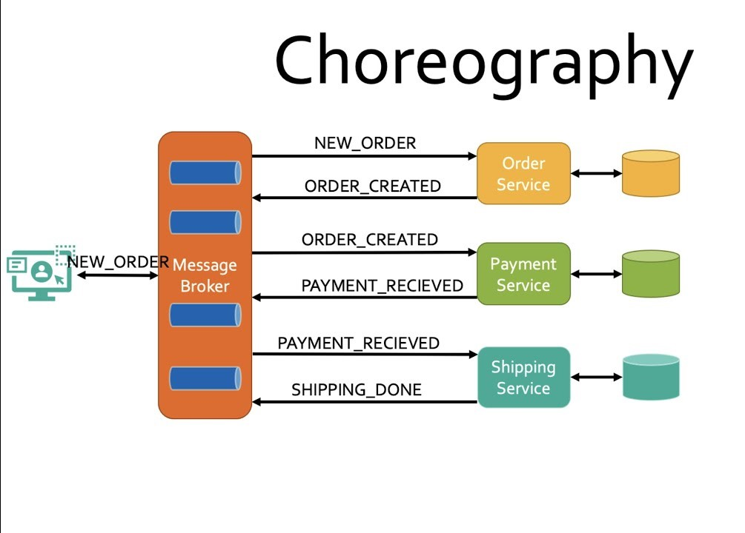
Choreography-based Saga
In the Choreography-based Saga, each microservice listens for events from other services, performs a specific action in response, and then publishes a new event to inform other services. There is no central control; instead, each service carries out its tasks based on the events it receives, creating a more decentralized structure.

Slide 14
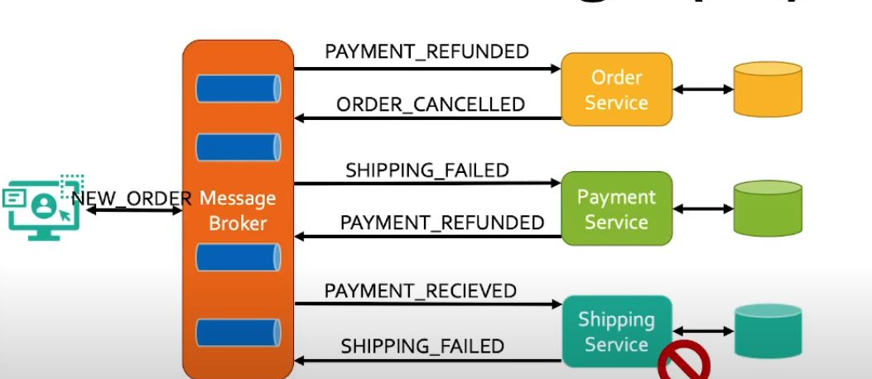
Choreography-based Saga(Failed Case)
In the Choreography Design Pattern, when an Shipping failed the order processing service generates a "ShippedFailed" event. This prompts the payment service to issue a "PaymentRefunded" event. Subsequently, the order management service listens for this event and triggers an "OrderCanceled" event, effectively managing the failure through a decentralized process.

Slide 15
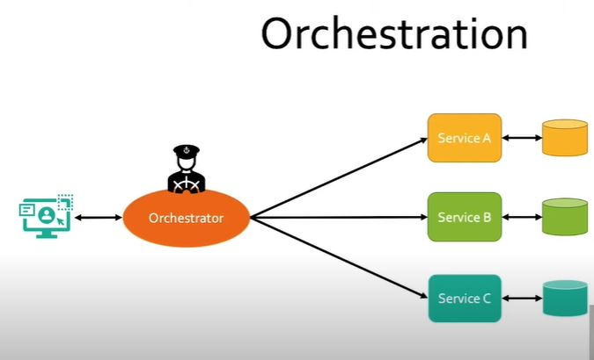
Orchestration-based Saga
The Orchestration Design Pattern is an approach where a central service, called the orchestrator, manages the flow of operations across multiple microservices by sending commands to them. The orchestrator coordinates the entire workflow by issuing commands to specific microservices, directing them to perform their tasks in the correct order. If any task fails, the orchestrator can trigger compensating actions to maintain consistency. This centralized control structure allows for simplified monitoring and management of processes.

Slide 16
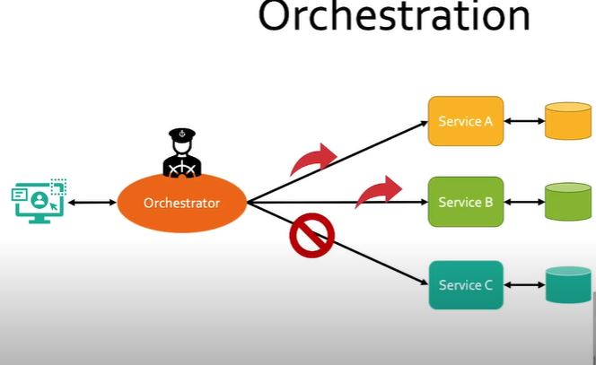
Orchestration-based Saga (Failed Case)
In an orchestration design pattern, if Service C fails to ship the order, the orchestrator detects the failure and triggers compensating actions. It sends a command to Service B to refund the payment and to Service A to cancel the order. This centralized control ensures that failures are handled smoothly by coordinating compensation across Service A, Service B, and Service C, maintaining data consistency.

Slide 17
Kafka
Real-time event streaming platform.

Slide 18
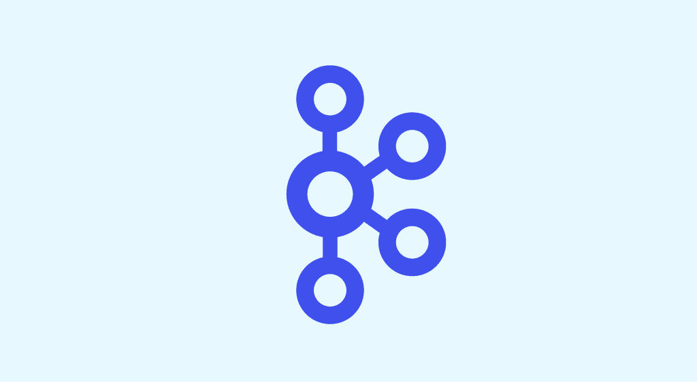
Kafka
Apache kafka is an open source distributed event streaming platform.
Kafka is a distributed event streaming platform that enables applications to act as event publishers and subscribers. Publishers send events (messages) to Kafka topics, while subscribers (or consumers) read and process those events in real time, allowing for efficient communication .

Slide 19
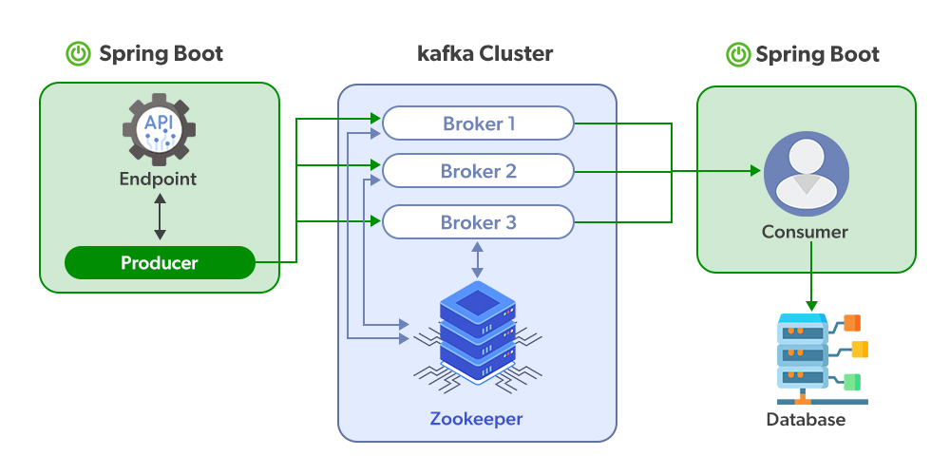
Kafka
Know your material in advance
Anticipate common questions
Rehearse your responses
Maintaining composure during the Q&A session is essential for projecting confidence and authority. Consider the following tips for staying composed:
Stay calm
Actively listen
Pause and reflect
Maintain eye contact

Slide 20

Components Of Kafka
Producer: Sends messages (data) to Kafka topics. It pushes real-time data into the system.
Consumer: Reads messages from Kafka topics. It processes or uses the data that was sent by producers.
Kafka Broker: A Kafka server that stores and manages messages. Multiple brokers work together to handle large data volumes.
Kafka cluster is a group of Kafka brokers (servers) working together. They store, manage, and distribute messages across multiple servers to handle large amounts of data reliably.

Slide 21

Partition: Each topic is divided into smaller parts called partitions. This helps distribute data and improve performance. Topic: A category where messages are organized and stored. Producers write messages to topics, and consumers read from them.
Offset: A unique identifier for each message in a partition. It helps consumers track which messages they’ve read.
Zookeeper: Coordinates and manages Kafka brokers. It ensures Kafka runs smoothly by handling tasks like leader election

Slide 22
Thank you
-Atharva Raskar
atharva.raskar@bnt-soft.com
-Vijaya Mahajan
vijaya.mahajan@bnt-soft.com

